Slide 1

COM3123 - Lecture 10
Angular Services & Observables

Slide 2
Topics
Nested Components
Angular Services
RxJS
Obsevables

Slide 3
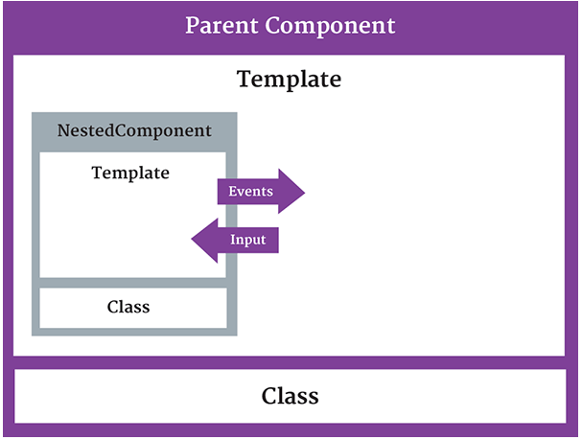
Nested Components
We can add a nested component by using a component as a directive within
another component.
@Input decorator allows data to flow from parent component to child
@Output decorator exposed an EventEmitter property that emits events to parent component

Slide 4
Services

Slide 5
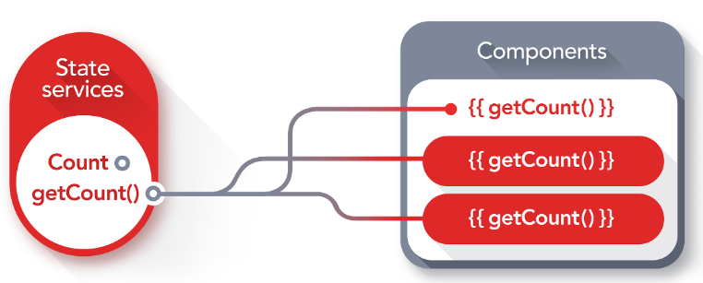
Angular Services
Services allow for greater separation of concerns for your application
Service are singletons that carry out specific tasks (* when registered in AppModule)
Better modularity by allowing you to extract common functionality out of component
Dependency Injection to allow components to access the service across application
Components should delegate tasks to the server ie. fetching data.

Slide 6

Dependency Injection
Dependency Injection is when one object supplies the dependencies of another object.
A dependency is an object that can be used (ie. a service)
An injection is the passing of a dependency to a dependent object (a client) that would use it.
https://angular.io/guide/dependency-injection
SOLID principles/Inversion of Control
Promotes Loose Coupling
DIC Containers ie. AutoFac, NinJect

Slide 7
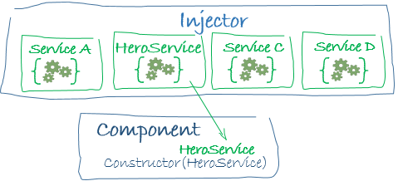
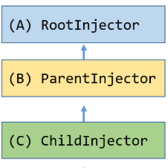
Angular Injector
Angular comes with it’s own dependency injection framework for resolving dependencies.
The Angular dependency injection system is hierarchical. There is a tree of injectors that parallel an app's component tree. You can reconfigure the injectors at any level of that component tree. (Angular 1.x => flat tree)
CLI Optimization tools can perform “tree shaking” to remove dependencies that are not used. This results is smaller bundle sizes

Slide 8
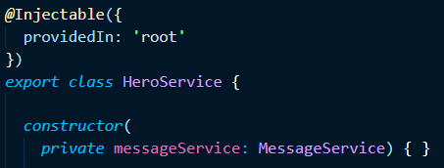
@Injectable Decorator
The @Injectable decorator is needed when a Service needs dependencies injected to its constructor.
Injectable() is optional, but common practice is to add the decorator for all services for consistency and so that when a service requires dependencies in the future you don't have to worry about adding it.
Angular CLI Command > ng generate service servicename

Slide 9
Retrieving Data Using HTTP

Slide 10

What is RxJS?
RxJs is a javascript library that brings concept of "reactive programming" to the web.
Reactive programming is programming with asynchronous data streams..
We "react" to changes that happen (click event, data fetched) instead of writing code to handle those changes ("imperative" programming).
Similar concepts found in Node.js Streams!
https://angular.io/guide/rx-library

Slide 11
Why RxJs?
Asynchronous event streams, ie. click events on which you can observe and do some side effect is not new.
RxJS can be thought of as writing assembly lines in your software applications. It allows you to write software that is reusable, configurable and asynchronous.
Possibilities are endless. Assembly lines (ie. RxJS Observables) can be chained together, split apart, configured different, or used without any modification at all

Slide 12
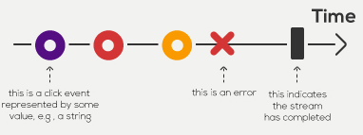
Observers and Observables
Observers allow you to push new data into an observable sequence.
It is "write-only" ie. observer can only add new cars onto an assembly line
An Observable is what we use to listen to, aka subscribe, to new changes that are emitted by an Observer.
It is a "Read-only" assembly line (you can only observe when new cars come off the assembly line)

Slide 13
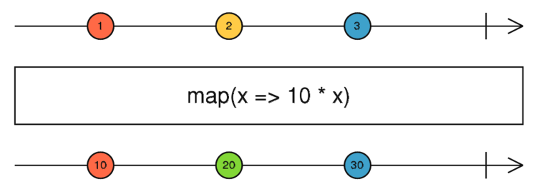
Observable Operators
Methods on observables that compose new observables
Transform the source observable in some way
Process each value as it is emitted
Examples, map, filter, take, merge https://www.learnrxjs.io/operators/
Map operator allows use to transform the incoming data as it receives it.
http://rxmarbles.com/#map

Slide 14
Promise vs Observable
Promise
Provides a single future value
Not lazy
Not cancellable
Observable
Emits multiple values over time
Lazy
Cancellable
Supports map, filter, reduce and similar operators

Slide 15
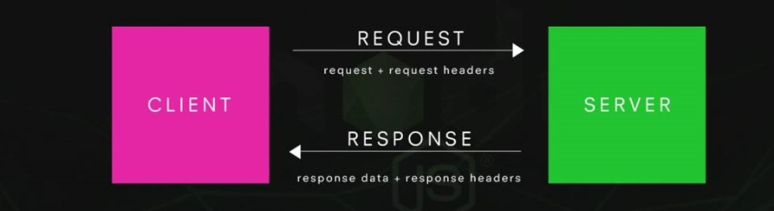
Sending an HTTP Request

Slide 16
Angular HTTP Service
HTTP service is available as an injectable class, with methods to perform http requests.
Calling requests returns an Observable which will emit a single Response when a response is received
Just like Angular 1.x, it's recommended that Http calls are wrapped within services instead of being used in Components directly.
- This allow for greater flexibility in you application structure
Notes:
This allows for greater flexibility in your application structure.

Slide 17
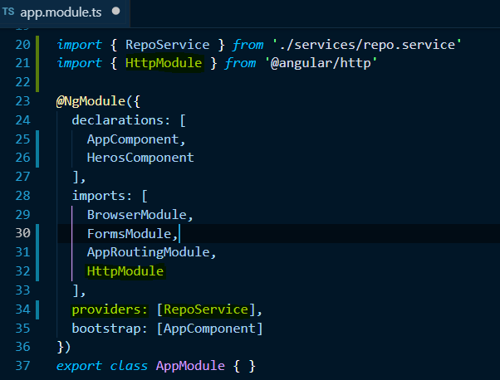
Registering Service in App.Module
Register the HTTP service in the AppModule to be used throughout the app
Import HttpModule from @angular/http, which contains all provider we need to make requests
* It is recommended that Http calls are wrapped within services instead of being used directly in Components. (flexibility, testing)

Slide 18
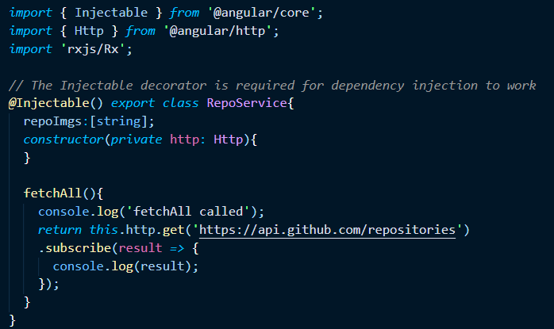
Sending an HTTP GET Request

Slide 19

Single Responsibility Principle
A class should have only one responsibility
Separation of Concerns - class should do one specific concern and do it well.
For example, a Component should deal with UI logic, and a Service should provide data.

Slide 20
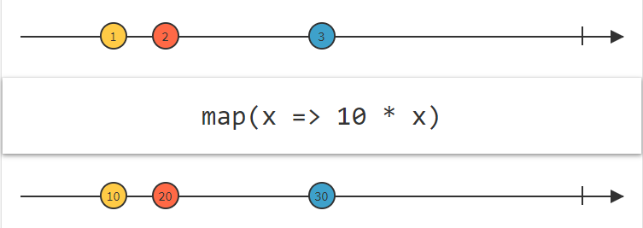
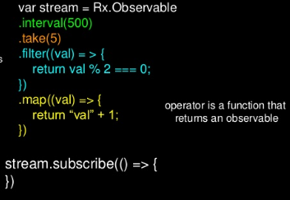
Observable Operators
Operators allow you to perform operations on your code
Operators are methods on the Observable type, such as .map(...), .filter(...), .merge(...), etc.
An Operator is a function which creates a new Observable based on the current Observable. The previous Observable stays unmodified.

